Slide 1
Coach Notes
Encourage students to build their own attachments for the stepper motor such as making flags using paper and tape or cardboard to attach other items to it.
Also tell the students to keep the power module off unless they are using the motor to ensure that the battery doesn’t die quickly.

Slide 2
Machine Learning with Raspberry Pi
Lesson 3: Stepper Motor
AI Code Academy

Slide 3
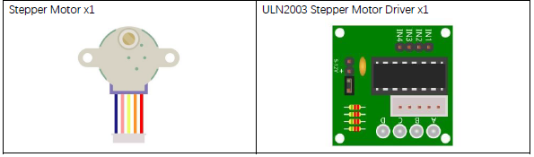
Materials Needed
For this lesson, we’ll need the following materials:
Raspberry Pi with SSH and VNC connection
Breadboard
GPIO extension board
Stepper Motor
Stepper Motor Driver Breakout Board

Slide 4
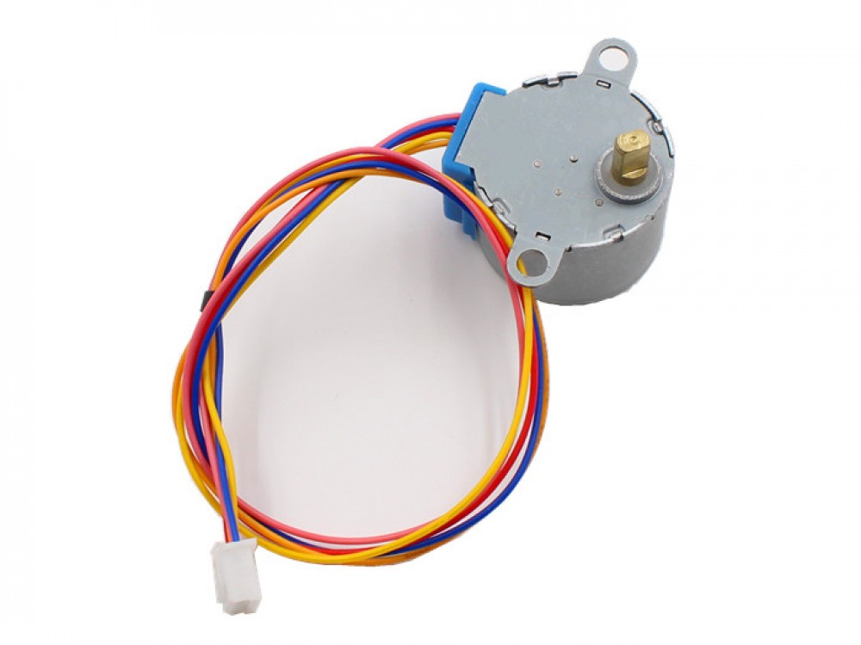
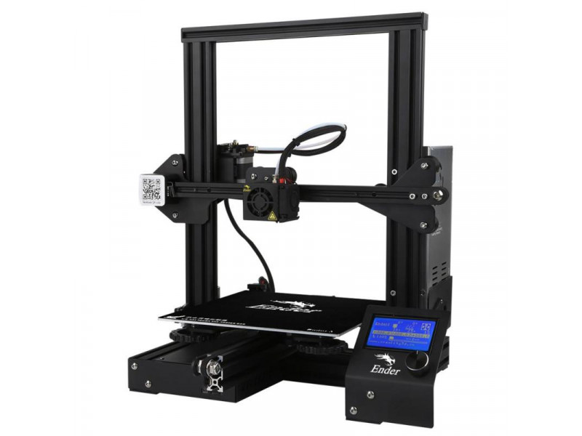
Stepper Motors
Stepper motors are widely used motors that can be controlled to move in precise increments known as steps.
Stepper motors can be found in devices such as 3D printers, DVD players, and cameras.
Stepper motors can rotate continuously in one direction, change directions, and be can move at precise angle increments.
Steppers have capabilities similar to the servo and DC motor.

Slide 5
Stepper Motors
One drawback of the stepper motor is they require more power to operate and may not turn as fast as other motors. Another difference drawback is the stepper motor cannot turn to an exact angle like the servo since it does not have a control chip.
Inside, stepper motors are comprised of a cogged wheel with four coils (magnets) that form a ring around the wheel.
We will send a pulse to a coil and the teeth closet to that coil will become attracted to it and move it in a step.
The sequence of pulses that we send will affect the direction the motor spins and the frequency we send that at will affect the speed.

Slide 6
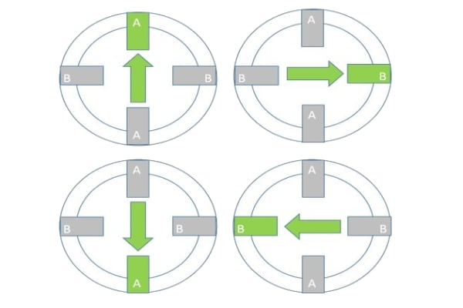
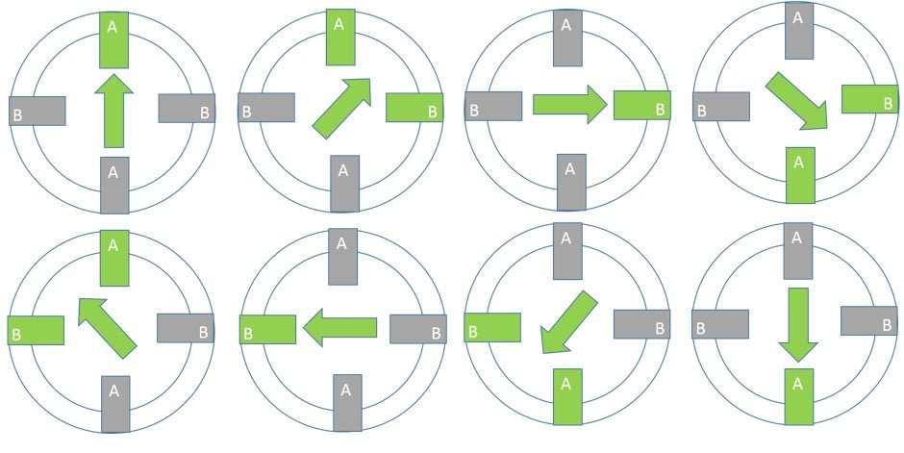
Stepper Motors
The motor requires about 2048 steps in order to complete one revolution, so each step rotates the motor about .17 degrees.
This calculation will be important when we want to turn the motor by a certain amount.
There are different methods for moving the motor, we can use a half step, full step, and double step motion. The step method will affect the speed our motor rotates at.
We will not use the double step due to practicality concerns.

Slide 7
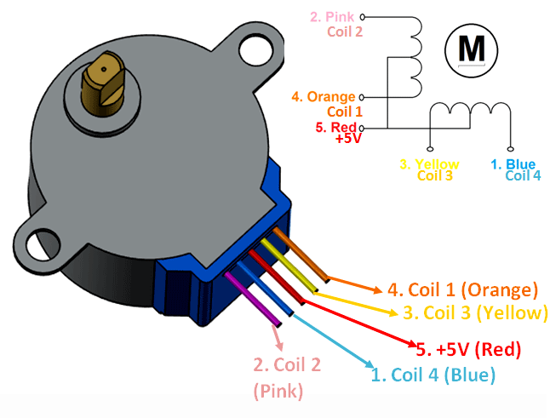
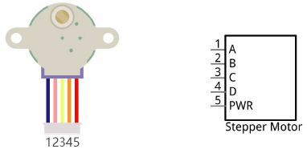
Stepper Motors
The stepper motor has 5 pins, A-D and PWR.
The A-D pins are the different coils inside the motor, and we will be sending HIGH and LOW pulses to these pins to control the motor’s rotation.
The PWR pin is the main power for the motor and we will be connecting this to the power module to ensure that the motor has ample power.

Slide 8
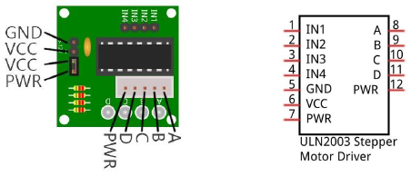
ULN2003 Stepper Motor Driver
The ULN2003 Stepper Motor Driver will allow us to provide more power to the motor and boost the signals we send from the Raspberry Pi since the Pi’s GPIO pins cannot drive the motor.
The pins IN1-IN4 pins correspond to the A-D inputs on the stepper motor.

Slide 9
Clock Wise Travel Sequence
The sequences move 4 steps, the half-step is a smoother and slower travel sequence.
A 1 represents a high pulse sent to that wire on the motor.
To travel in the opposite direction, traverse the sequence in the reverse order.
Half Step Sequence
Step | A | B | C | D
1 | 0 | 0 | 0 | 1
2 | 0 | 0 | 1 | 1
3 | 0 | 0 | 1 | 0
4 | 0 | 1 | 1 | 0
5 | 0 | 1 | 0 | 0
6 | 1 | 1 | 0 | 0
7 | 1 | 0 | 0 | 0
8 | 1 | 0 | 0 | 1
Full Step Sequence
Step | A | B | C | D
1 | 0 | 0 | 0 | 1
2 | 0 | 0 | 1 | 0
3 | 0 | 1 | 0 | 0
4 | 1 | 0 | 0 | 0
Double Step Sequence
Step | A | B | C | D
1 | 0 | 0 | 0 | 1
2 | 0 | 1 | 0 | 0

Slide 10
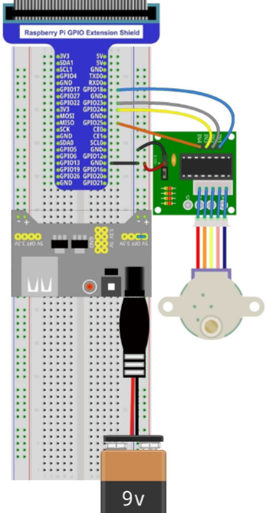
Project Circuit

Slide 11
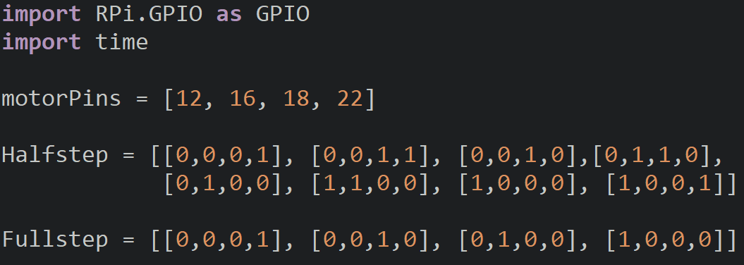
StepperMotor.py
We will create a list to store the pin numbers and two lists with the Half and Full step sequences in the proper order.

Slide 12
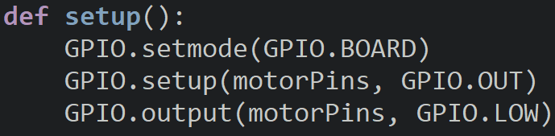
StepperMotor.py
In the setup function we will set the board mode and then make all the motor pins outputs.
We will also clear the pins to ensure that the motor does not move after setting the pins up.

Slide 13
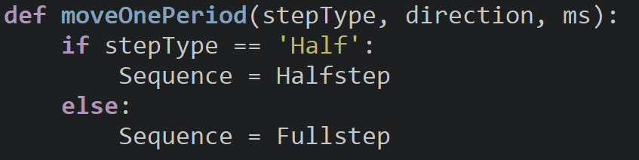
moveOnePeriod()
The moveOnePeriod function will take the stepType, the direction (CW or CCW) and the sleep duration in milliseconds as parameters.
If the stepType is half step, we will set the sequence variable to be equal to the half step and otherwise it will be the full step.

Slide 14
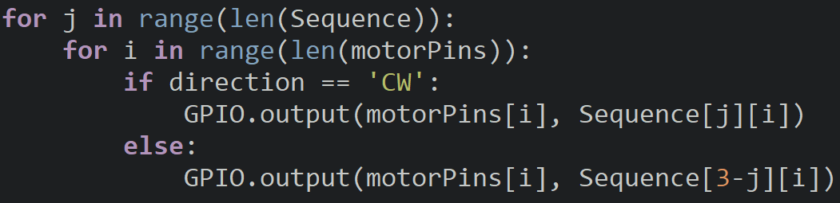
moveOnePeriod()
We will then have a for loop to loop through all pins configurations for the sequence we have chosen. Nested inside that for loop is another for the values of the motorPins.
If the direction is clockwise, we will output to the selected motor pin its corresponding value in the sequence. If the direction is counterclockwise, we will use 3-j to index the sequence so that we traverse the sequence (list) in reverse.

Slide 15
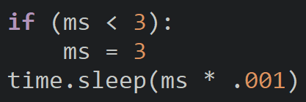
moveOnePeriod()
Finally, we will add a delay so that the motor can move in the direction we have chosen.
The if statement ensures that the delay is not lower than 3ms so that we remain within our speed limit.
Inside the time.sleep call we multiply the ms by .001 to convert it to milliseconds.

Slide 16
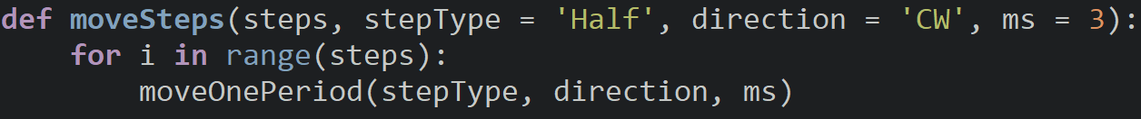
moveSteps()
For the moveSteps function we will pass to it how many steps we want to move (4 step increments), the step type we want to use, the direction to move, and the time delay.
Default values are Half step in the clockwise direction with a 3ms delay.
A for loop will call the moveOnePeriod function for the number of steps we want to move.

Slide 17
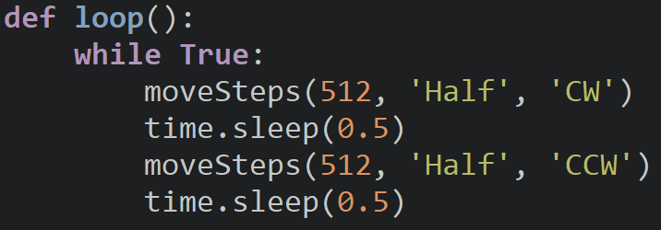
Loop
The loop calls the moveSteps function to rotate the stepper one revolution clockwise and one revolution counterclockwise.
We use 512 for our steps since we move 4 steps when we call the period function. If we want to travel one revolution, we need to move 2048 steps and if each period is 4 steps, we will need to repeat the period 512 times.

Slide 18
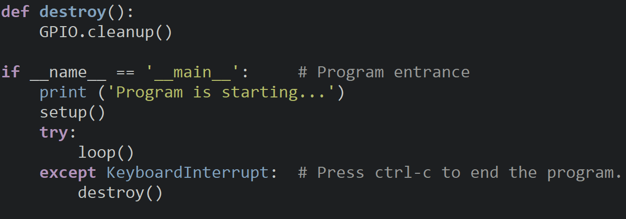
Program Entrance & Destroy

Slide 19
Discussion
How does the stepper motor compare to the other ones we have used in our classes?
Do you prefer one motor type over the others?
What projects could we make with the stepper motor?

Slide 20
Power off
As usual, shut down your pi properly before disconnecting power.

